Slide 1

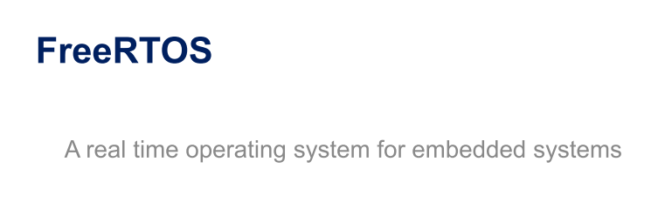

Learning, Research and Sharing
Community

Slide 2
What is a Real Time OS?
It’s a OS, Specially designed to run applications with very precise timing and a high degree of reliability.

Slide 3



Market leading RTOS by Real Time Engineers Ltd.
Professionally developed with strict quality management
Commercial versions available: OpenRTOS and SafeRTOS
Documentation available on www.freertos.org
Free support through forum (moderated by RTOS author Richard Barry)

Slide 4
Preemptive or cooperative real-time kernel
Tiny memory footprint (less than 10kB ROM)
Includes a tickless mode for low power applications
Synchronization and inter-task communication using
message queues
binary and counting semaphores
mutexes
group events (flags)
Software timers for tasks scheduling
Execution trace functionality
CMSIS-RTOS API port

Slide 5
Core resources:
• System timer (SysTick) – generate system time (time slice)
• Two stack pointers: MSP, PSP
Interrupt vectors:
• SVC – system service call (like SWI in ARM7)
• PendSV – pended system call (switching context)
• SysTick – System Timer
Flash memory:
• 6-10kB
RAM memory:
• ~0.5kB + task stacks

Slide 6
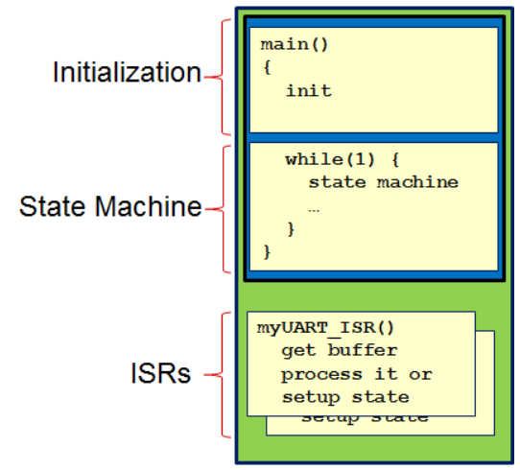
Bare-Metal vs. RTOS
Initialization: Initializing the hardware and software components in main().
Super-loop state machine: Code to manage the application. The actions are based on the results of the interrupts (e.g. a SPI packet was received or a timer expired) or by polling.
ISRs: Code executed by interrupts for peripherals (e.g. UART), timers or other device specific items (e.g. exceptions or multi-core communication).
Bare-metal applications have their place. They are generally small, fast and relatively easy to understand with a simple application. Once more complicated logic is required, an RTOS starts to shine.

Slide 7
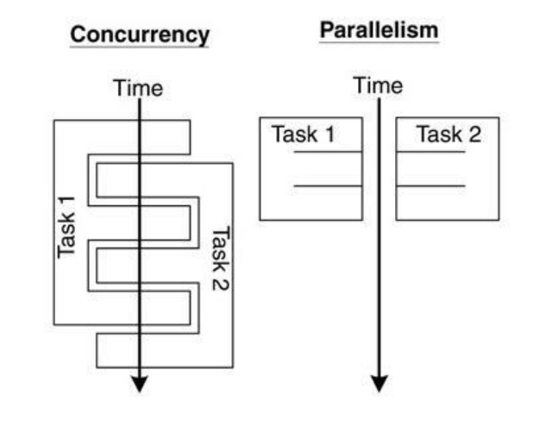
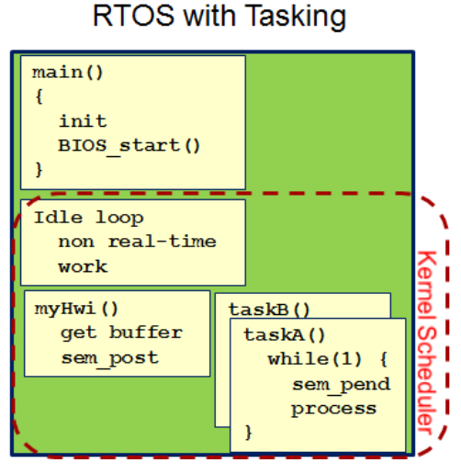
Bare-Metal vs. RTOS
Notes:
The major factor in deciding between an RTOS and a bare-metal scheduler is whether the system needs preemption. If preemption is a requirement then an RTOS is the way to go! The ability to suspend a task and have a higher priority task execute is one of the RTOS's major advantages. The system's real-time performance can be greatly enhanced if the priorities of tasks are set appropriately. At the bare-metal level, a developer might argue that preemptive behavior can be obtained by using interrupts and setting interrupt priorities. To some degree this is true, but such interrupts should be fast, short, and sweet. Attempting to use an interrupt to preempt a currently running function could affect the system's real-time performance.

Slide 8

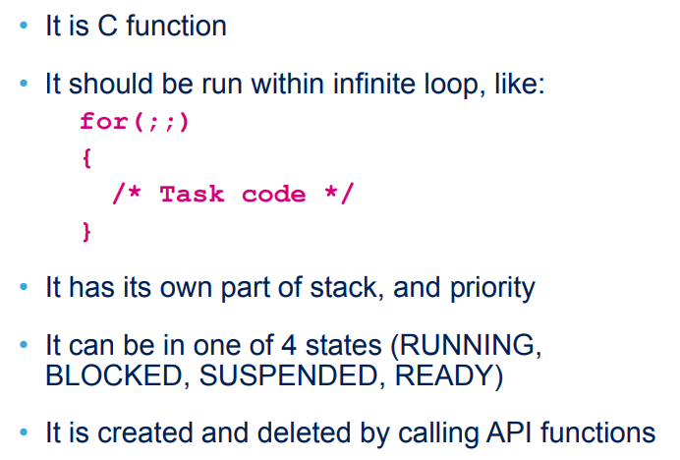
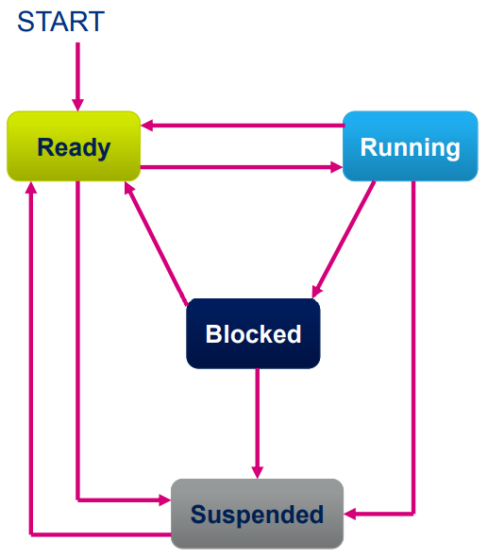

Notes:
Tasks are implemented as C functions - Each task is a small program.
It has an entry point, will normally run forever within an infinite loop, and will not exit.

Slide 9

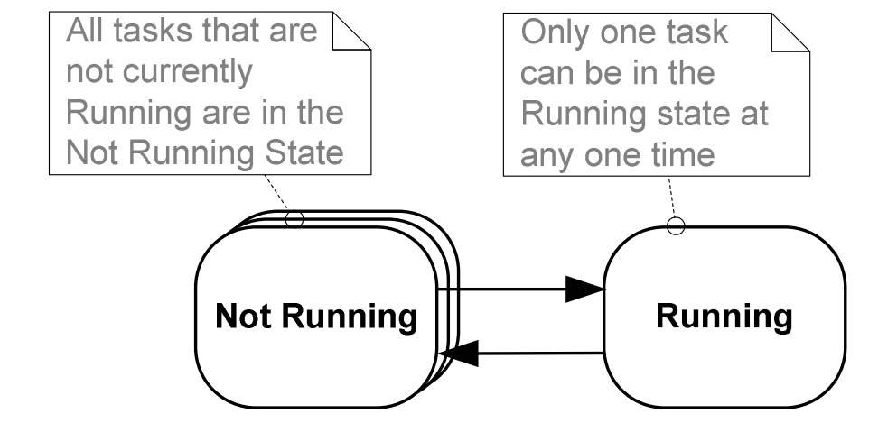
An application can consist of many tasks. If the microcontroller running the application only contains a single core then only one task can actually be executing at any given time. This implies that a task can exist in one of two states: Running & Not Running

Slide 10
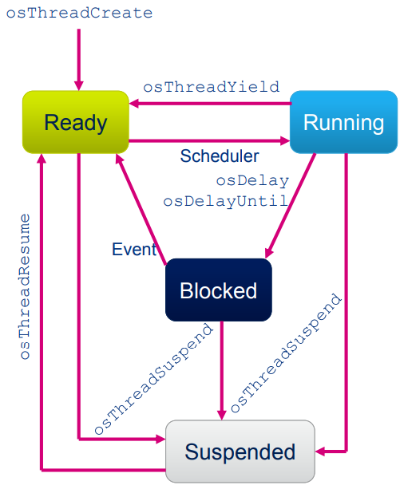
Ready
Task is ready to be executed but is not currently executing because a different task with equal or higher priority is running
Running
Task is actually running (only one can be in this state at the moment)
Blocked
Task is waiting for either a temporal or an external event
Suspended
Task not available for scheduling, but still being kept in memory

Slide 11

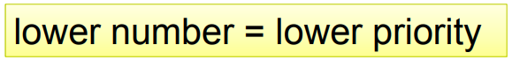
Each task is assigned a priority
The order of execution of tasks depends on this priority
The scheduler activates the task that has the highest priority of all tasks in the READY state
Task with higher priority can preempt running task if config USE_PREEMPTION is set
Task priorities can be changed during work of the application

Slide 12
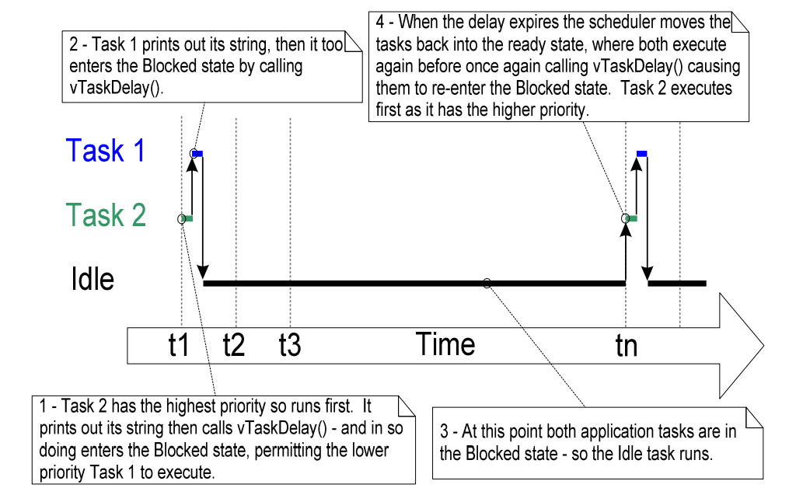
IDLE task
The idle task is created automatically when the scheduler is started to ensure there is always at least one task that is able to run (at least one task in the Ready state).
The execution sequence when the tasks use vTaskDelay() in place of the NULL loop

Slide 13

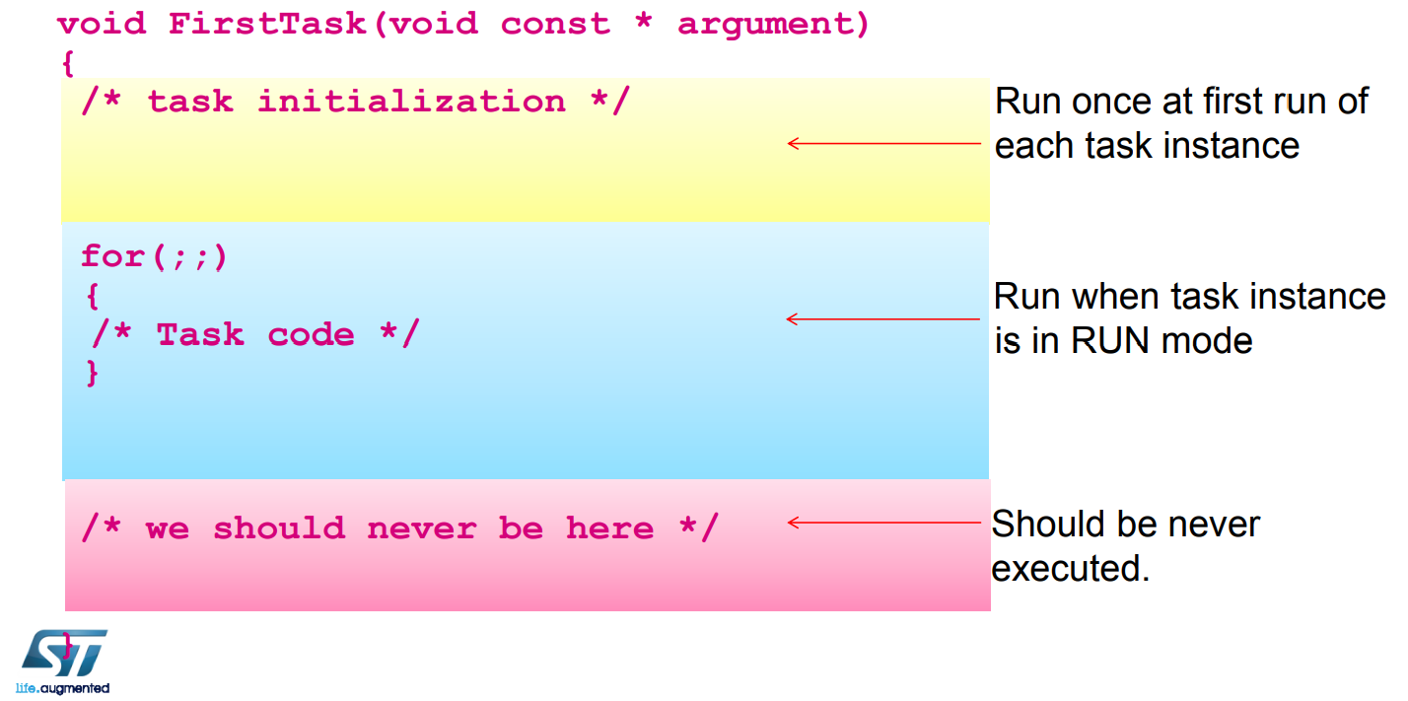

Slide 14

The scheduler is an algorithm determining which task to execute.
Common point between schedulers is that they distinguish between tasks being ready to be executed (in READY state) and those being suspended for any reason (delay, waiting for mailbox, waiting for semaphore(s),…)
The main difference between schedulers is how they distribute CPU time between the tasks in READY state.
Each task is assigned a priority
Each task can exist in one of several states
Only one task can exist in the Running state at any one time.
Notes:
What is round-robin scheduling algorithm

Slide 15
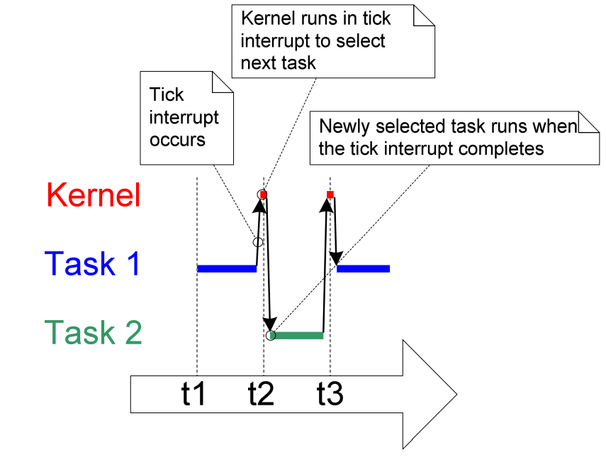
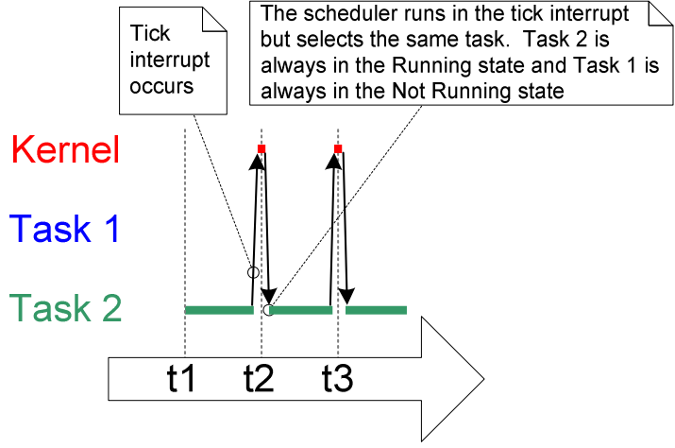
To be able to select the next task to run, the scheduler itself has to execute at the end of each time slice. A periodic interrupt called the tick interrupt is used for this purpose.
the same priority
one task has a higher priority than the other

Slide 16

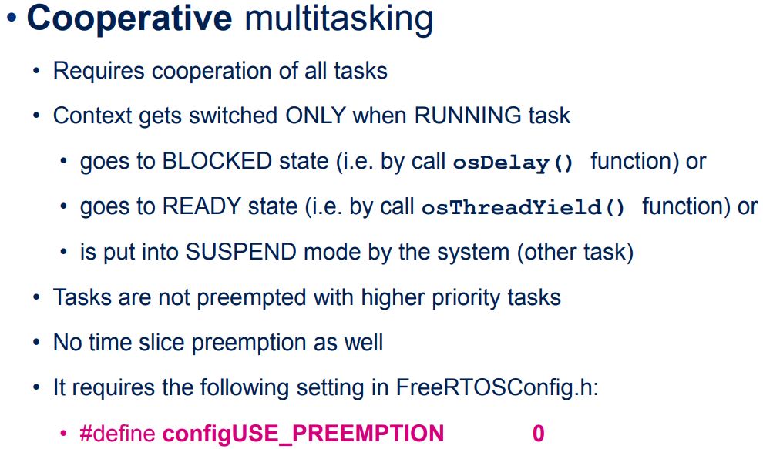

Slide 17
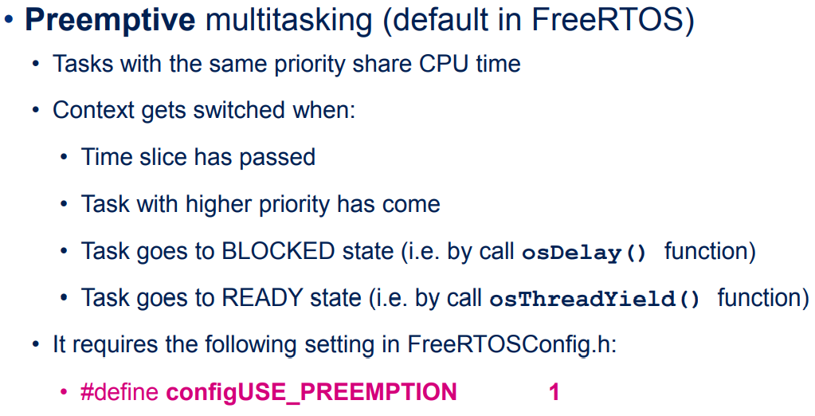

Slide 18

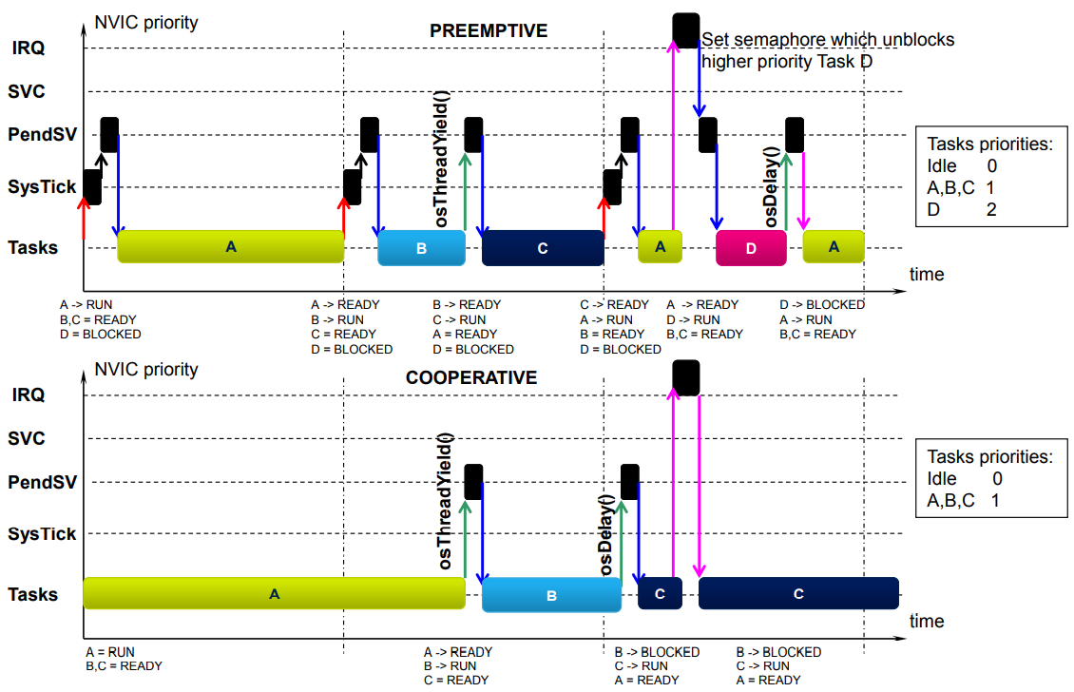

Slide 19



Slide 20
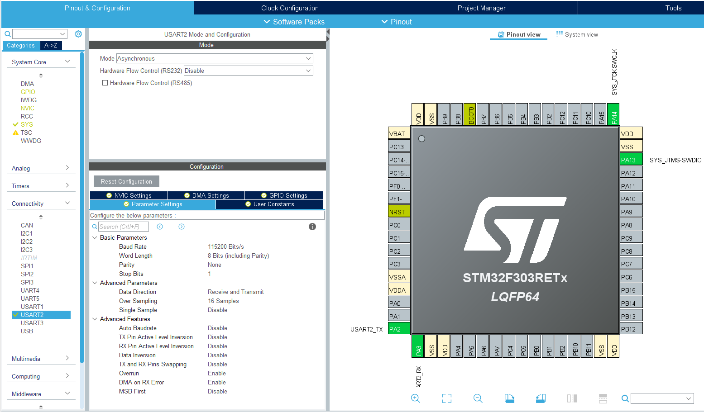
USART2 Settings

Slide 21

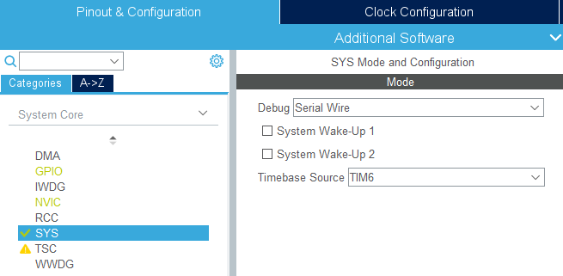
Start a new project within STM32CubeMX for selected MCU
Go to System Core section -> SYS and change Timebase source (for HAL) from SysTick to other timer i.e. TIM6
Notes:
Why?

Slide 22

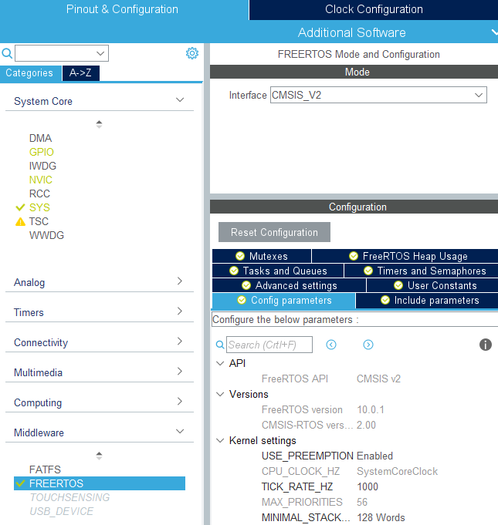
Go to Pinout&Configuration tab, select Categories->MiddleWare->FreeRTOS and select CMSIS_V2 in Mode window
Go to Configuration tab to configure FreeRTOS parameters – refer to next slides for details

Slide 23
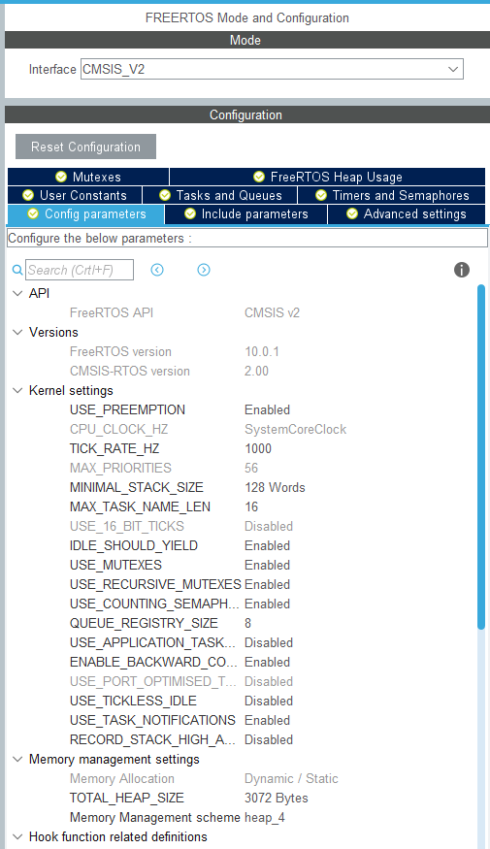
Config parameters tab
Kernel settings
RTOS components settings
Memory setup
Include parameters tab
Include some additional functions, not necessary for FreeRTOS run
Tasks and Queues tab
Creation of tasks and queues
Timers and Semaphores tab
Creation of timers and semaphores (binary, counting)
Mutexes tab
Creation of mutexes

Slide 24

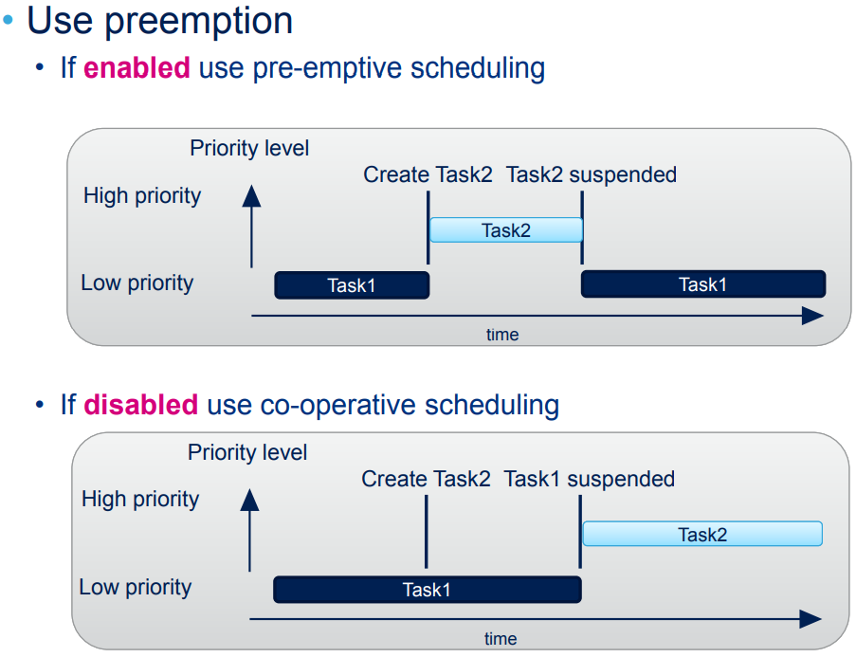

Slide 25

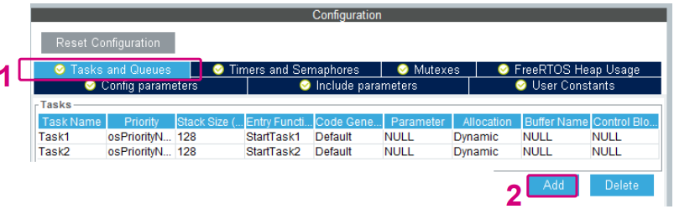
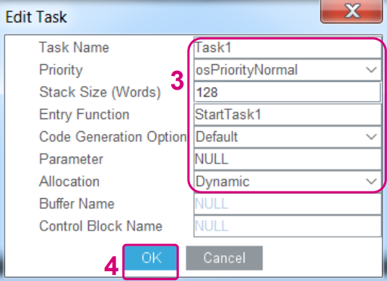
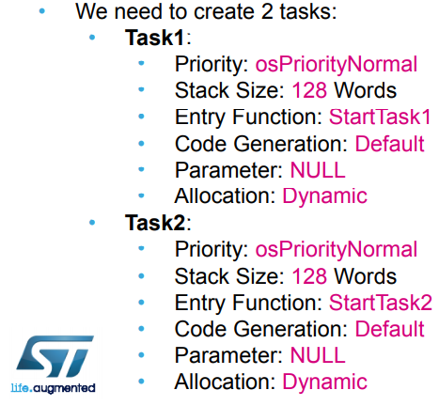
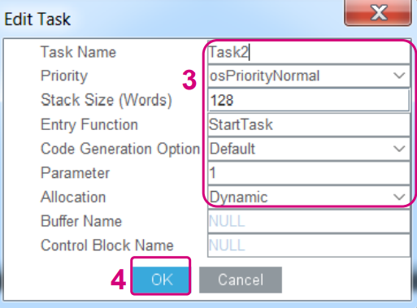
Press FreeRTOS button within Pinout&Configuration tab

Slide 26
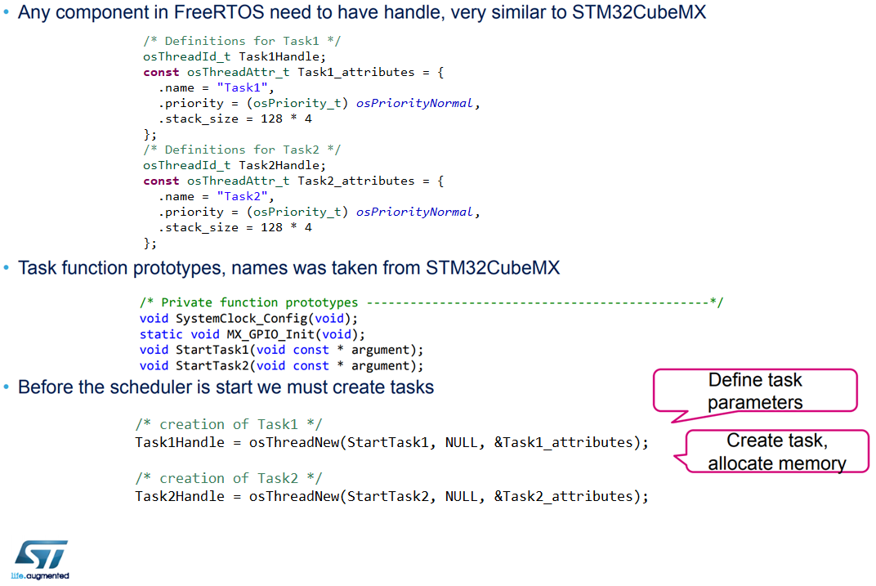

Slide 27
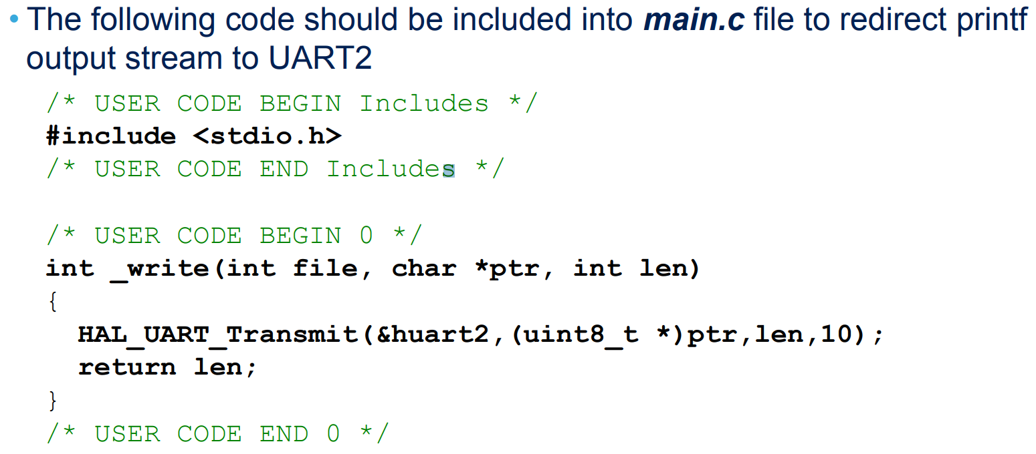

Slide 28

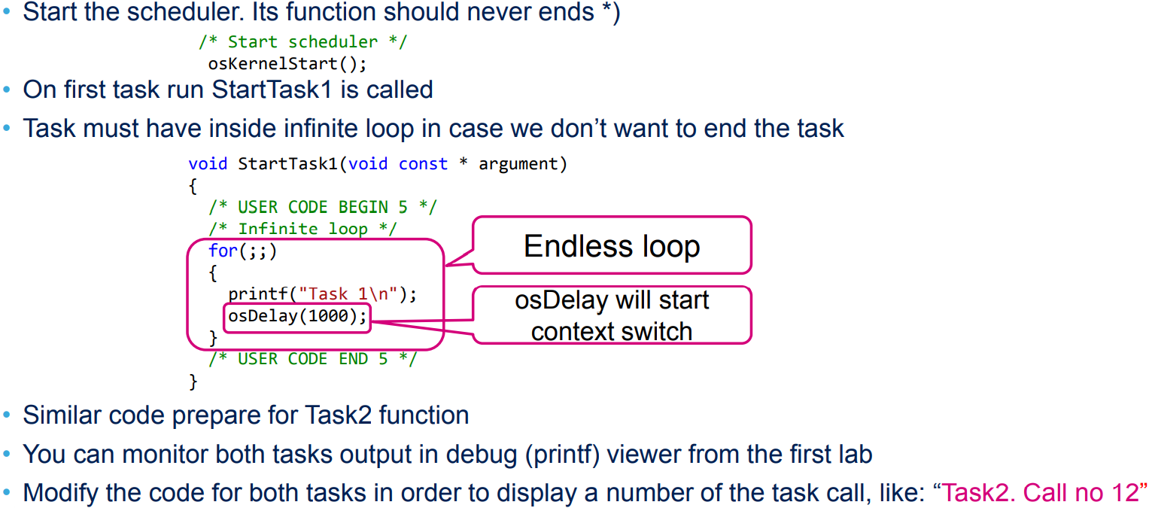

Slide 29

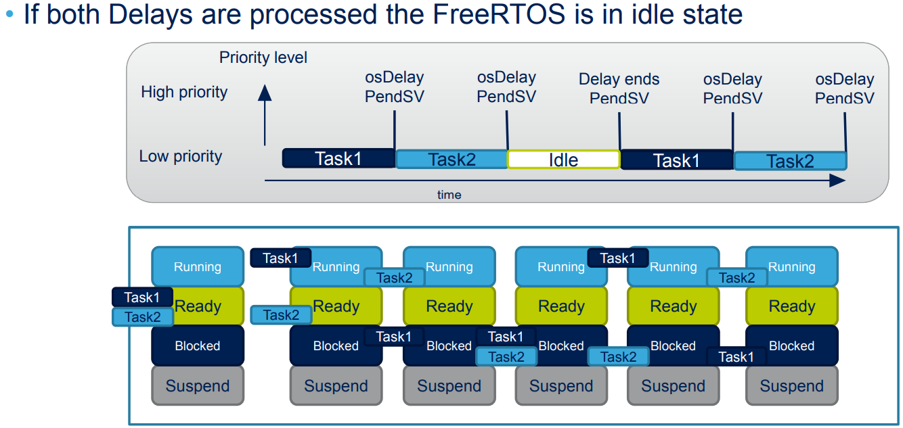

Slide 30

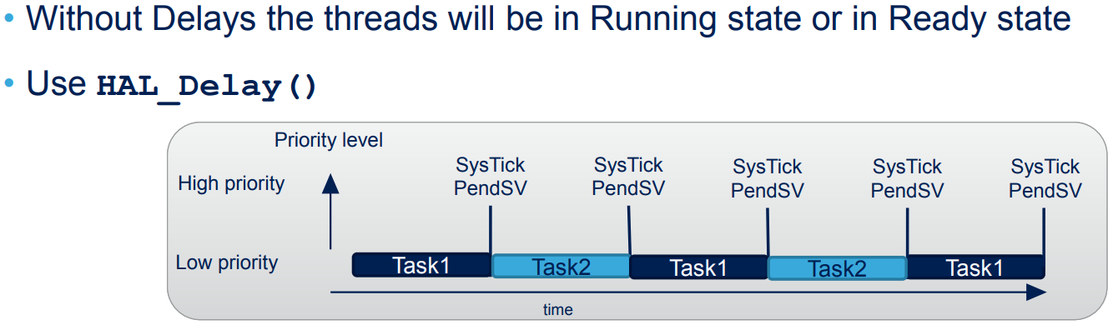
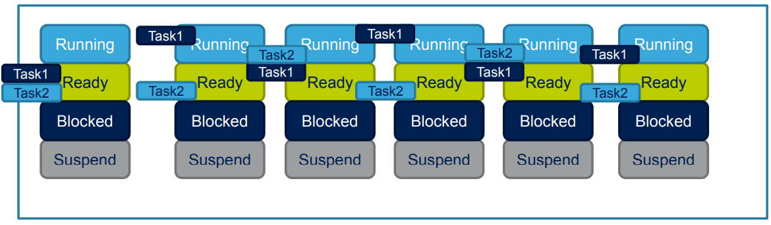

Slide 31

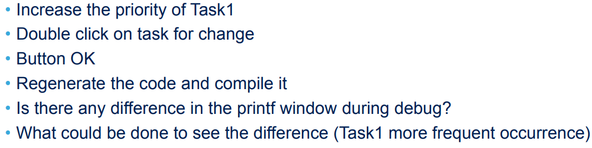
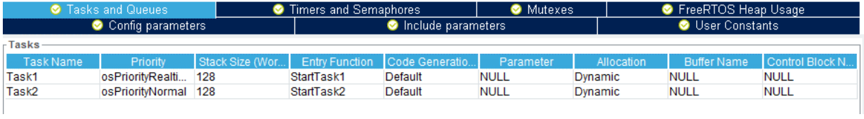

Slide 32

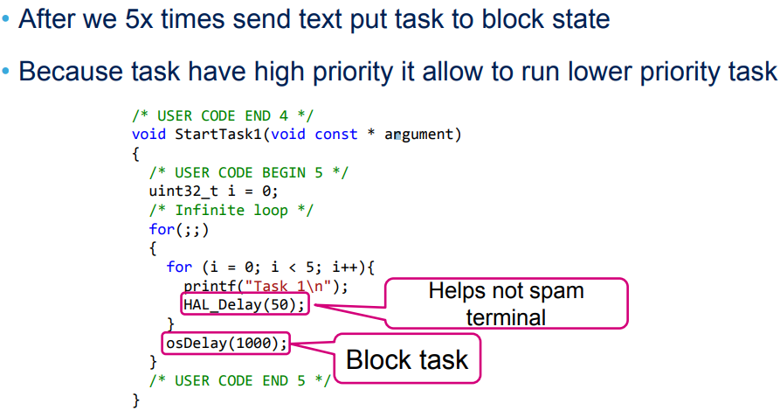

Slide 33

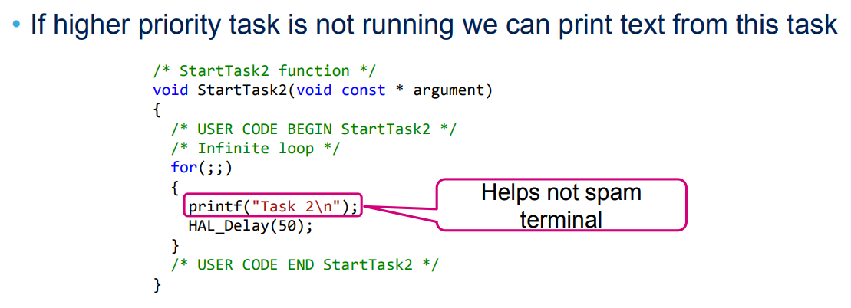

Slide 34

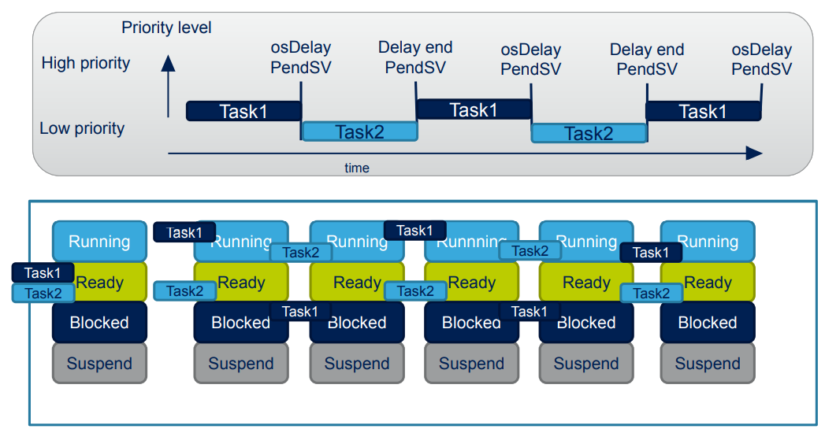

Slide 35
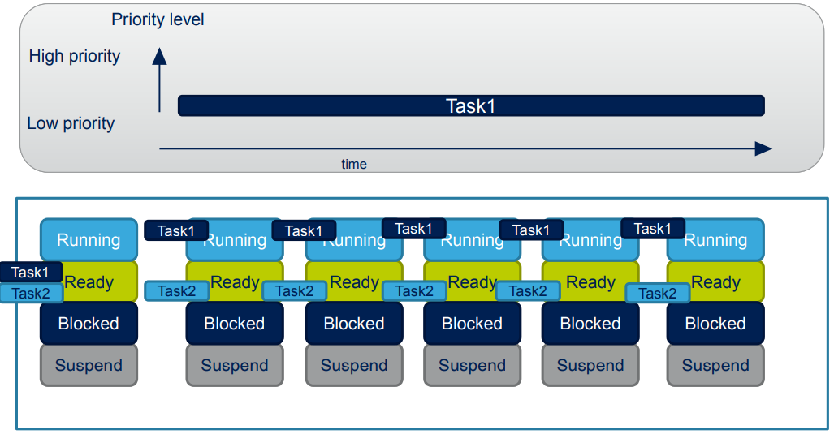

Slide 36
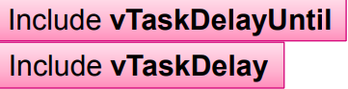

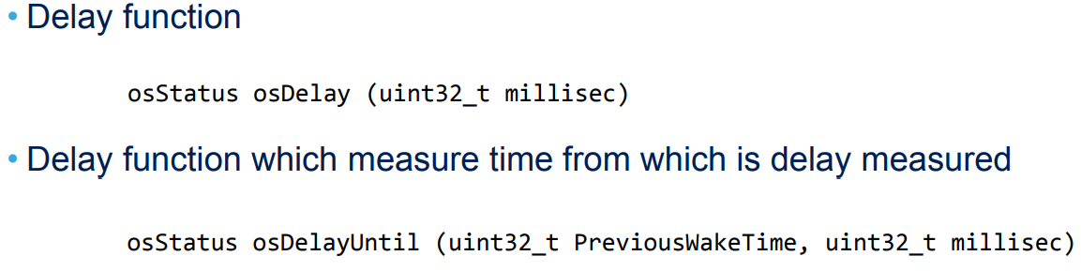
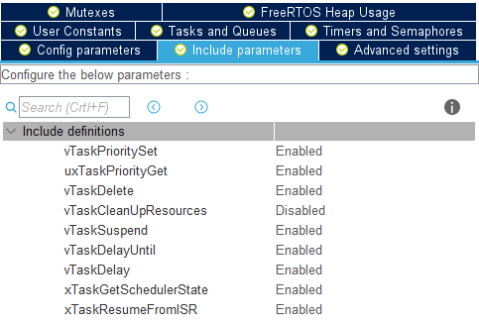

Slide 37

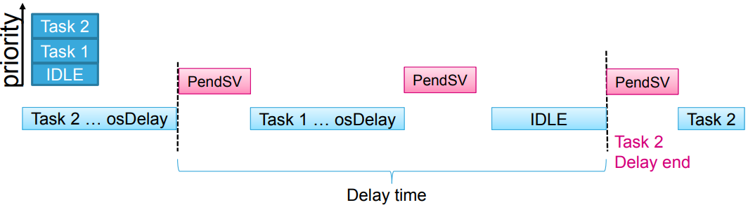

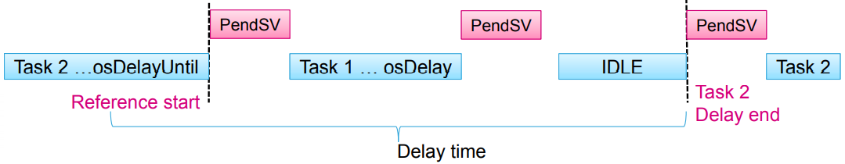

Slide 38

FreeRTOS uses a region of memory called Heap (into the RAM) to allocate memory for:
Tasks
Queues
Semaphores
Mutexes
when dynamically creating variables (malloc & free).
FreeRTOS heap is different than the system heap defined at the compiler level.
The total amount of available heap space is set by config TOTAL_HEAP_SIZE
It is possible to select type of memory allocation

Slide 39
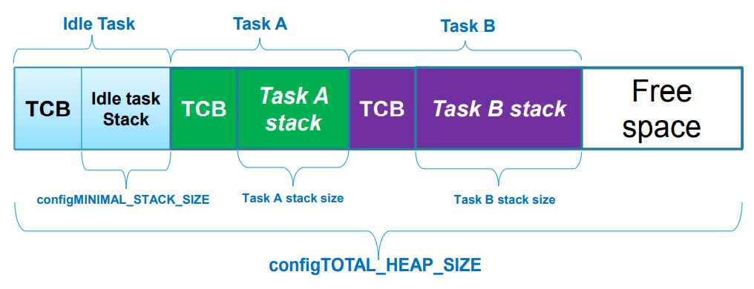
Each created task (including the idle task) requires a Task Control Block (TCB) and a stack that are allocated in the heap.

Slide 40
End.

Slide 41
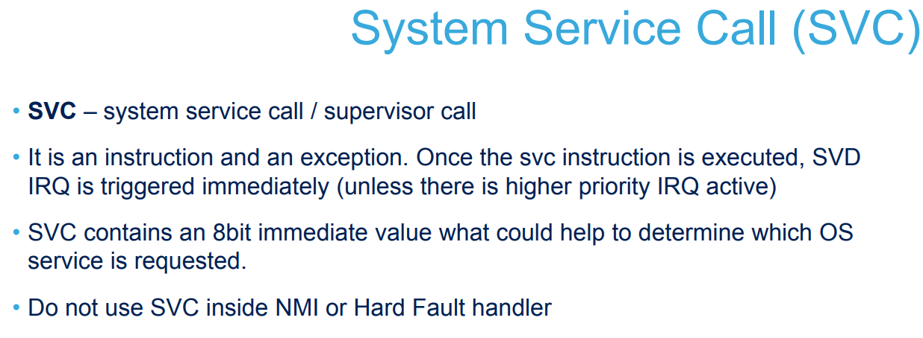

Slide 42
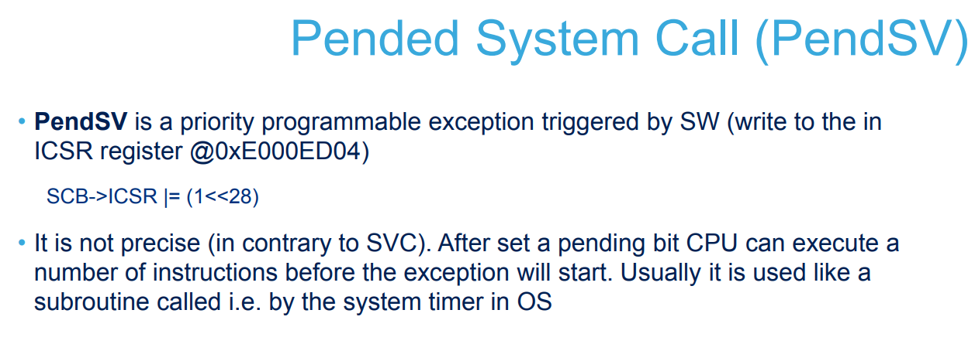

Slide 43
